Slide 1
Replication Title: Women bureaucrats and petty corruption. Experimental evidence from Ghana.
Idi Amin Da Silva

Slide 2
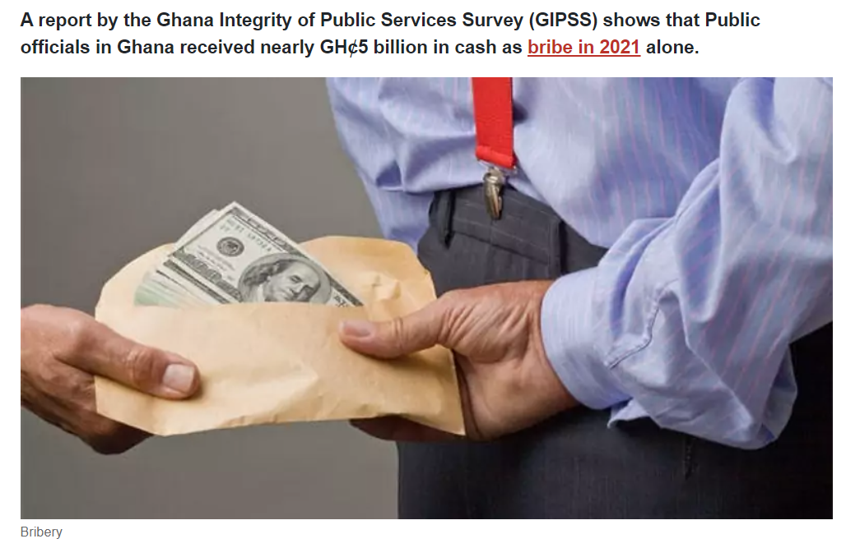

Slide 3
More women in public institutions are correlated with lower levels of corruption.
The study of the replication has two main goals:
1st To assess the claim that citizens expect women bureaucrats to be less likely to extract bribes than their male counterparts.
In the context of the Ghana where the corruption is understudied despite being a central obstacle to development (Gyimah – Boadi, 2015)

Slide 4
2nd goal of the replication paper
Investigate potential mechanisms that may explain a relationship (positive or negative) between gender and corruption. To answer these questions let consider 3 mechanism:
(a) Women are expected to have inherent or socially induced traits that make them less corrupt.
(b) The women are expected to be less corrupt because they have fewer opportunity to engage in corruption.
(c) The women are expected to be less corrupt because they face less external financial pressure to support their extended families or kinship groups.

Slide 5
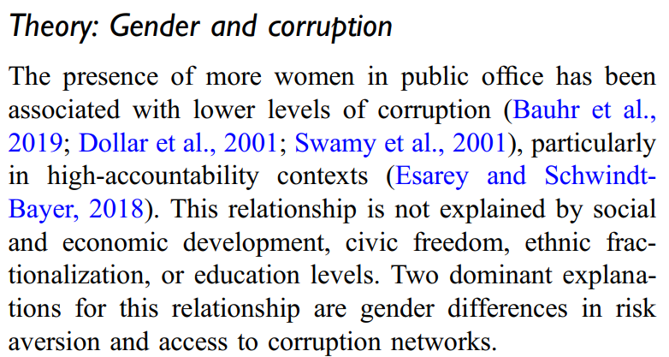

Slide 6
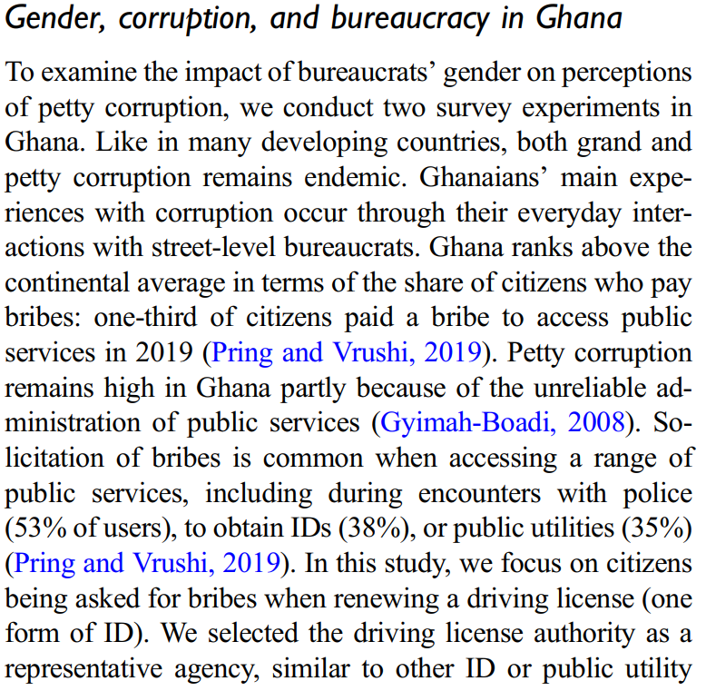

Slide 7
MY CONTRIBUTION TO REPLICATION PAPPER
DATA VISUALIZATION AND APPLICATION OF SUITABLE STATISTICS REGRESSION MODEL: AN ORDERED AND UNORDERED MULTINOMIAL LOGISTICS REGRESSION

Slide 8
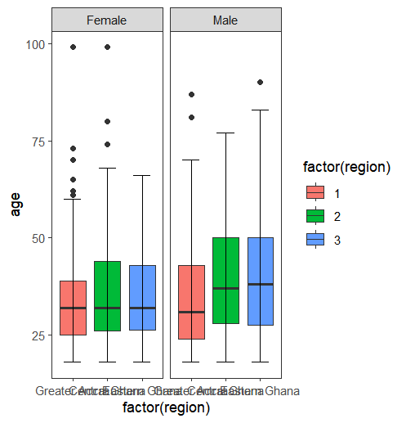
Boxplot of region (Greater Accra, Central Ghana, Eastern Ghana) versus age and facet wrap by sex

Slide 9
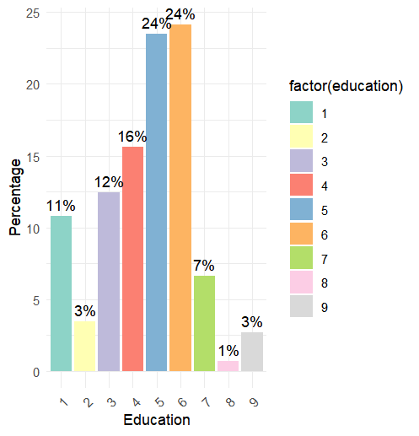
Bar plot of Education

Slide 10
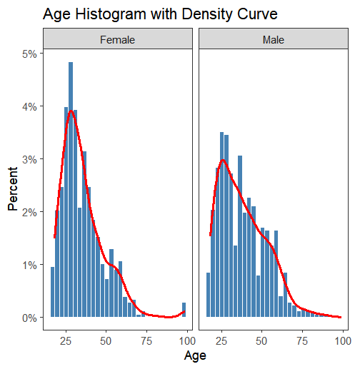
Histogram of the variable age with density curve by sex

Slide 11
My contribution in term of statistical Analysis modelling
I have decided to choose the an ordered and unordered Multinomial Logistic Regression Model by choosing the response variable region: 1= Greater Accra; 2=Central Ghana; 3=Eastern Ghana. The reference category is Greater Accra.
The Explanatory Variables:
Sex (female; male);
married (single, married);
children (numbers of children)
Christ (non – Christian; Christian)

Slide 12
Research Question:
How do factors such as gender religion and number of children influence the likelihood of bureaucrats public servant residing and working in regions other than Greater Accra are most likely to solicit a bribe from public?

Slide 13
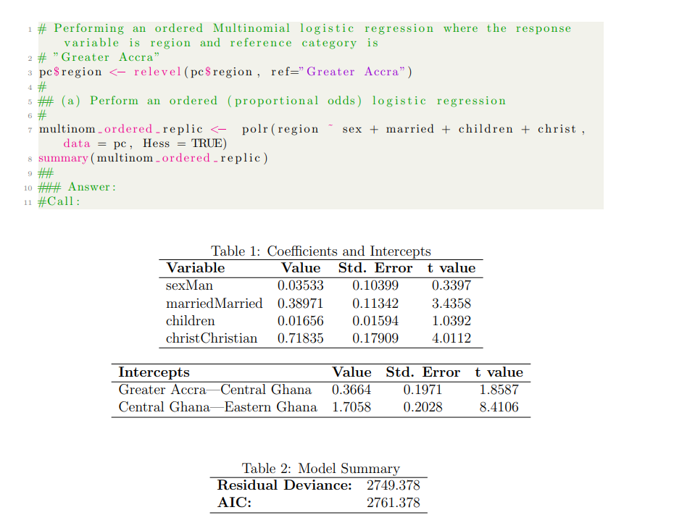
An ordered Multinomial Logistics Regression Model:

Slide 14
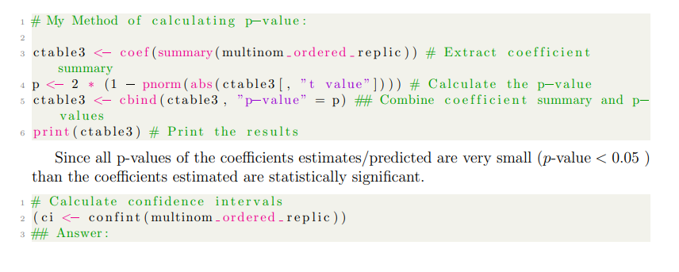
P- Values for an ordered multinomial logistic regression

Slide 15
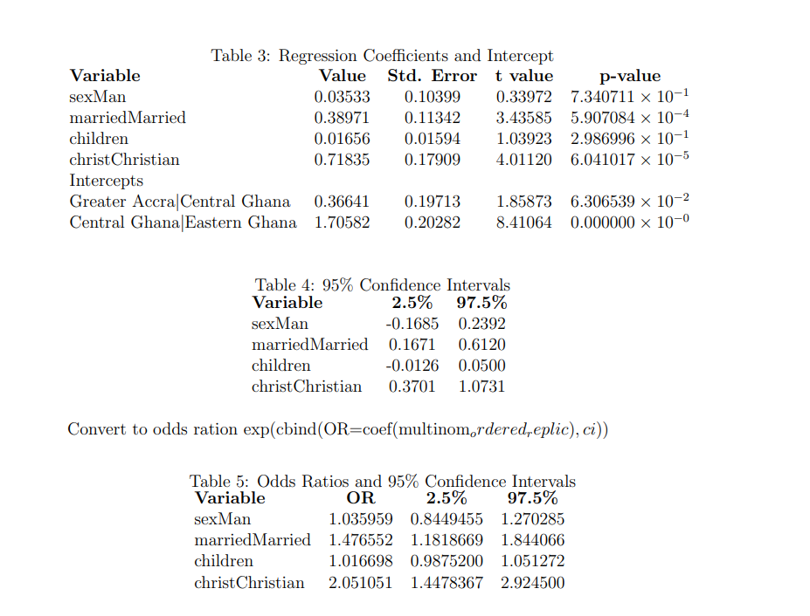
P-Values summary table:

Slide 16
Conclusion
Previous studies has showed a negative correlation between the adherence of women in public and private sector and practices of the corruption acts.
This facts should encourage more companies to recruit women to integrate the labour market with the aim to reduce corruption and to bust the efficiency, efficacy and productivity.

